Slide 1
HEALTHCARE
WEB APP
Chandan Lal - ENG17CS0055
Varshini K - ENG18CS1007
Deepak R Purohit - ENG17CS0062
8th semester A section

Slide 2
THE PROBLEM

Slide 3
INTRODUCTION
The traditional doctor-patient relationship has evidently remained the same over the course of time. The patient goes to the doctor if he/she feels unwell. The doctor listens to the patient, evaluates the symptoms and forms a diagnosis. This may lead to long waiting times for other patients who still await treatment, which is undesirable, as it is not possible to maintain social distancing in most government hospitals due to lack of proper infrastructure for it.
Technology has changed the way how patients communicate with doctors and not only that, but also how healthcare is administered. To make healthcare system more interactive a diagnostic a smart system which improves access to healthcare is designed.

Slide 4
PROBLEM STATEMENT
During the pandemic there was a huge backlog of general patients suffering from various illnesses other than corona. There was usually very little time for a specialist doctor to diagnose a patient and assign medicines accordingly.
A person’s medical history will remain hidden to a new health practitioner unless mentioned by the patient himself.

Slide 5
SOLUTION
Designing and implementing a web based application with AI by providing help to patients with right guidance for health care and give physicians access to valuable data to support decision-making.
To build a permanent database like a identification number that a person’s medical history is always shown to a new medical practitioner who will get to know it and diagnose a symptom accordingly.

Slide 6
LITERATURE REVIEW

Slide 7
[1]Intelligent Health Diagnosis Technique Exploiting Automatic Ontology Generation and Web-Based Personal Health Record Services
Authors: Gun-Woo Kim,Dong-Ho Lee
Conference Name and Place : IEEE Access,Department of Computer Science and Engineering, Hanyang University, Seoul 04763, South Korea .
Publishing Year : 2019

Slide 8
About
The proposed system is an intelligent health diagnosis technique that exploits automatically generated ontology and Web-based personal health record services.
The proposed technique first automatically generates a human disease diagnosis ontology by exploiting two well-established ontologies for diseases and symptoms: a large-scale medical database and an open biomedical repository.
When a user enters the symptom-based queries, possible diagnoses are identified.
Subsequently, the ranked diagnostic results are provided to the user via ranking methods that consider the user’s symptoms, personal health attributes, and multi level diagnosis.

Slide 9
[2]A novel approach for medical assistance using trained chatbot
Authors: Divya Madhu, Elmy Sebastian
Conference Name and Place : IEEE,International Conference on Inventive Communication and Computational Technologies (ICICCT), Seoul, South Korea.
Publishing Year :2017

Slide 10
About
The proposed idea is to create a system with artificial intelligence that can meet the requirements.It helps them to take the correct treatment.
The implementation of Personalized Medical assistant heavily relies on AI algorithms as well as the training data as discussed in this paper.
However, it is still in its early stage and levels and faces some challenges; some of which have a direct link to AI were discussed.
While other problems such as research and implementation costs, and government regulations are also challenges which are critical to the successful implementation of personalized medicine, but not addressed by the algorithms discussed in this paper.

Slide 11
[3]An Automatic Disease Diagnosis Method Based on Big Medical Data
Authors: Xo Luo, Jun Yang
Conference Name and Place : IEEE,International Conference on Information Science and Security (ICISS).Seoul, South Korea.
Publishing Year :2016

Slide 12
About
Medical diagnoses automation based on huge data is of great significance to doctor-patient contradiction regulation and the optimizing allocation of health resources.
This paper presents an intelligent automatic disease diagnosis system.
Based on a large number of confirmed disease cases, the method of probability and statistics is used to find the relations between the symptoms and different diseases.
The automatic disease diagnoses system has been implemented preliminarily and the system is proved having some value in clinical application.

Slide 13
[4] A Framework For Disease Identification From Unstructured Data Using Text Classification And Disease Knowledge Base
Authors: Fahim Faisal,Faisal Bin Ashraf
Conference Name and Place : IEEE,International Conference on Advances in Electrical Engineering (ICAEE).Dhaka, Bangladesh.
Publishing Year : 2020

Slide 14
About
In this paper,the proposed work is a web based automated disease identification framework which will take unstructured textual data like health forum posts as input and provide a ranking of probable diseases based on symptom-disease correlation considering all important factors.
A lexicographic and semantic feature-based two-phase text classification system .
A disease knowledge base-based similarity measurement module to identify probable disease have been incorporated in the proposed framework.
The framework is made by varying the number of feature components and got the result that, significant accuracy and reliability is obtained over baseline systems by effective feature engineering at the same time of keeping up with increased user interactivity.

Slide 15
[5]Design and Development of Diagnostic Chabot for supporting Primary Health Care Systems
Authors: Bushra Kidwai, Nadesh RK
Conference Name and Place : International Conference on Computational Intelligence and Data Science (ICCIDS 2019).School of Information Technology and Engineering, VIT Vellore,, India.
Publishing Year : 2019

Slide 16
About
Artificial Intelligence has changed the healthcare scenario. The proposed system aims to narrow the gap between healthcare and patients further.
AI concepts are used to fetch knowledge from medical database containing many diseases to develop an efficient diagnostic chatbot.
The chatbot asks the user questions in a format imitating a doctor-patient conversion.The questions are based on the users preceding input and then based on replies forms a possible diagnostic.
The diagnostic form is preliminary which might help the user decide on further action.The system needs to increase its database and improve the machine learning part to ensure better diagnosis.

Slide 17
REQUIREMENTS

Slide 18
FUNCTIONAL
REQUIREMENTS
Storage: Permanent database containing all medical details of a person needs to be stored and available securely only to doctors.
For Patients: A Patient ID is issued that is linked to a medical database that contains a patient’s medical history and records of medicines, allergies, etc. The patient should also be able to order medicines online and get it delivered.
For Doctors: Entering the patient ID into the system should access the database and get patient records.
For Pharmacists: Entering the patient ID should access the database and get medicinal requirement which has been entered by a doctor. Should be able to check the ID’s of people who have made online payment and deliver the medicines accordingly.

Slide 19
SOFTWARE
REQUIREMENTS
Code Editor :pycharm
Operating System : Windows or Linux
Backend: MySQL,Python
Frontend : HTML,CSS

Slide 20
HARDWARE
REQUIREMENTS
i5 processor-based computing or higher
Memory: 4GB RAM
Hard Drive: 50 GB

Slide 21
DESIGN

Slide 22
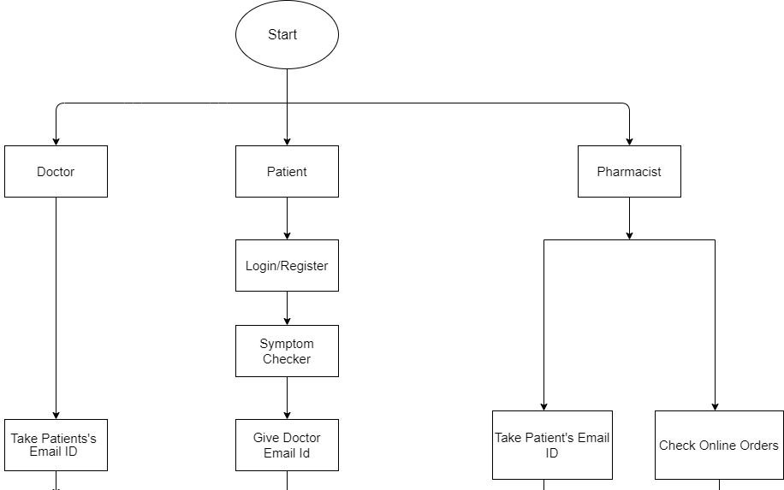
FLOWCHART

Slide 23
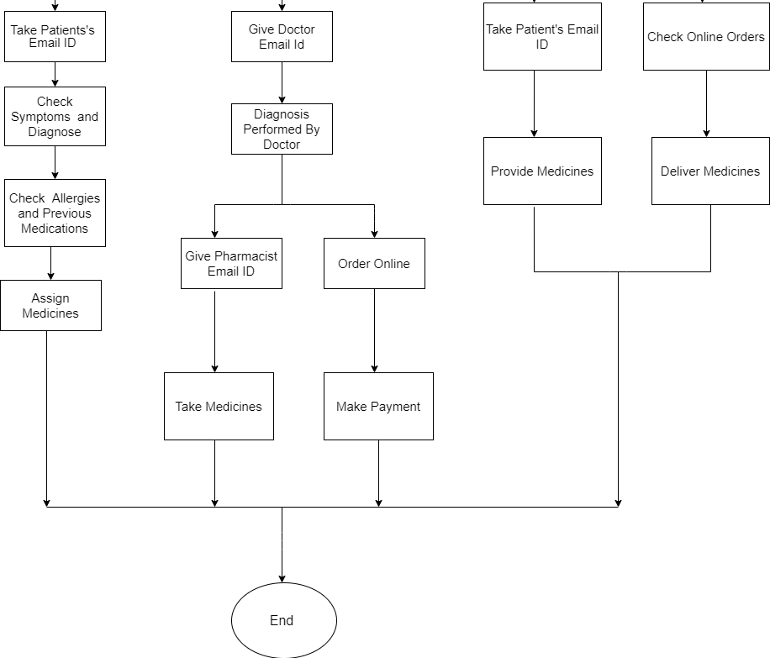

Slide 24
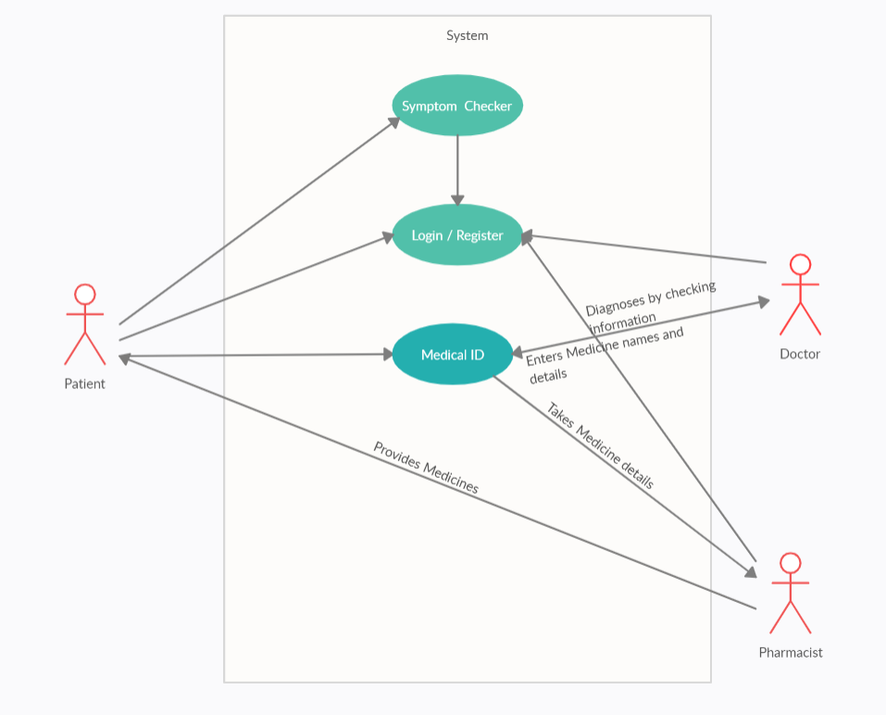
USE CASE DIAGRAM

Slide 25
IMPLEMENTATION

Slide 26
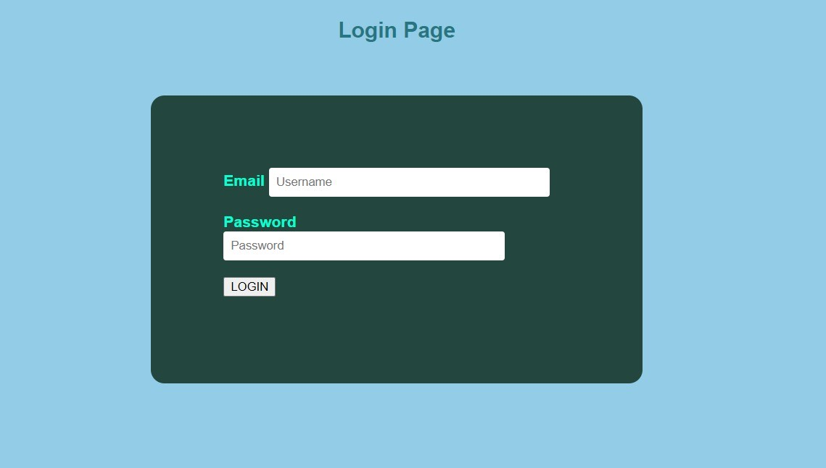
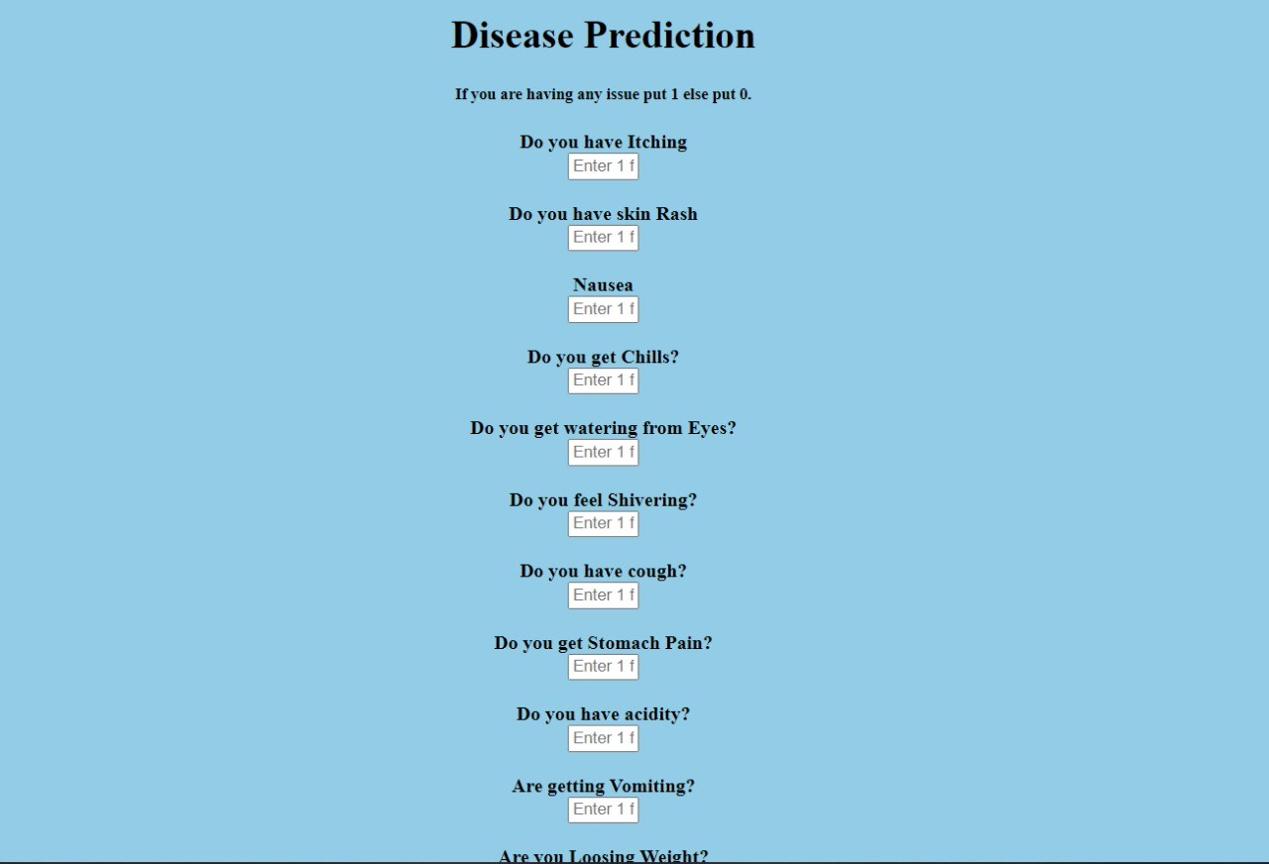
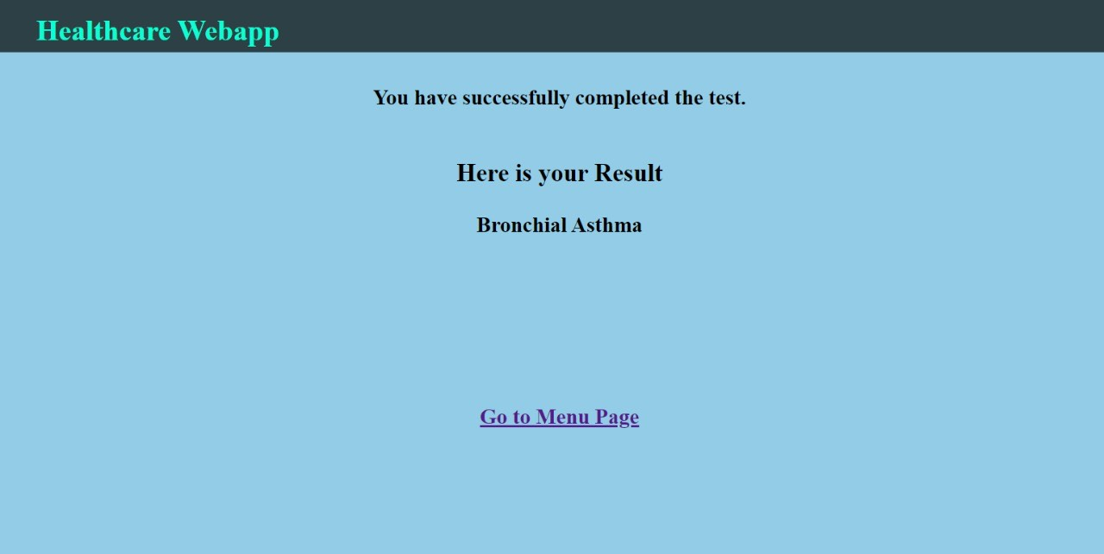
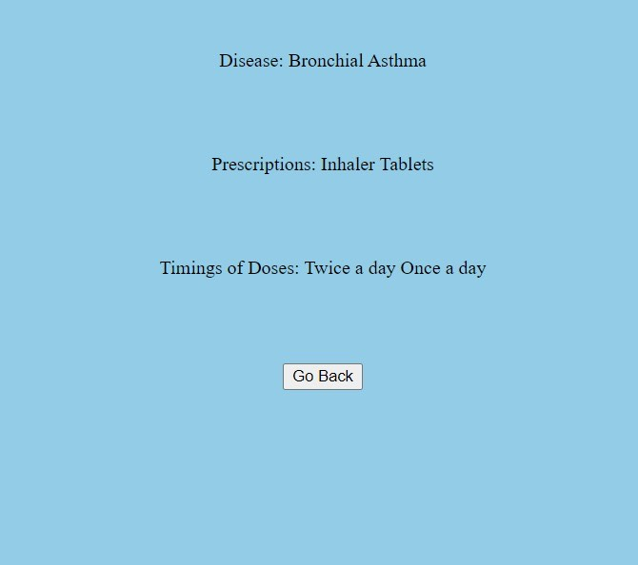

Slide 27
CONCLUSION
The implementation of Healthcare Web Application heavily relies on AI algorithms as well as the training data ,storing data and creating infrastructure as discussed . However, it is still in its early stage and levels and faces some challenges; some of which have a direct link to AI were discussed. While other problems such as research and implementation costs, and government regulations are also challenges which are critical to the successful implementation of web application with cloud based AI .

Slide 28
FUTURE WORKS
CHATBOT
MEDICAL ID
DATASETS

Slide 29
THANK YOU

